Slide 1



Partner Benefits from
The Sales Process
The Business Model
The Community
Slide <number>

Slide 2


















Aras Sales Process
Structured Path to Close
Interest
Qualification
Services
Support
Lead
Prospect
Customer
Customer
on Support
Downloads
Clear Criteria
Business Initiative
Project Champion
Technical Resource
Package
Proof =
PO
Proof =
Project
Definition
Consulting
Training
Multi-Year Contracts
+ Follow-on Service
Engagements
Aras Investment
Google Ads
Email Campaigns
Blogs & PR
Telemarketing Calls
WebEx Demos
Installation Support
Project Scoping
Site Visits
References
Exchange Meetings
Community Building
SW Enhancements
Slide <number>

Slide 3
Partner Benefits:
The Businessmodel
  Microsoft Open Distribution Benefits
  Removes Customer’s Up-front Capital Barrier
  Saves Client Budget for Partner Services
  Enables Partners to Install PLM Solutions
  for Future Projects without Initial Expense
  Partner Benefits
  Simple Partner Structure
  Partner is Productive Quickly
  Leverage Existing Microsoft Partner Skills
  Comprehensive Training & Documentation
Slide <number>

Slide 4






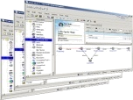







Partner Benefits:
The Community
The community can Download and use the Solution.
Partner creates a community Solution and exports the business objects for this Solution from his Innovator to a file
ARAS will Marketing the Solution under „Community Projects“ at the ARAS Homepage
The Partner and the Customer using the Solution are linked now
Slide <number>

Slide 5

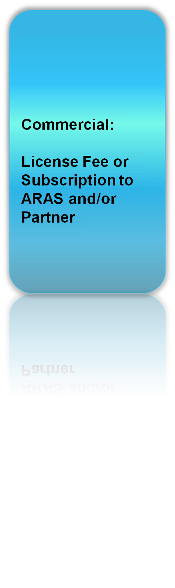
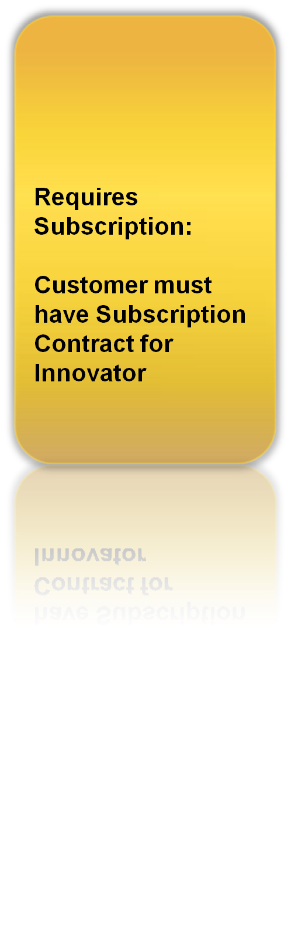



Partner Benefits:
Solution Types
Slide <number>

Slide 6

Business Model
How Aras & Partners Makes Money Together
Partner
Aras Corp
  SI Business Model
  Sells Consulting & Systems Implementation / Integration
  No Software to Sell or Request Customer Buy
  Can Sell Custom Solutions if Choose for Additional Revenue Opportunities
  Maintenance Business Model
  Sells Support Subscriptions
  [Maintenance Equivalent]
  Very Profitable, Highly Scalable
  No Obligation for Customer to Buy / No Obstacles
Slide <number>

